Slide 1

Database Systems
Department of Computer Science
Chungbuk National University
Seo-Young Noh

Slide 2

CHAPTER 3: Data Modeling Using the Entity-Relationship (ER) Model

Slide 3
Chapter Outline
Overview of Database Design Process
Example Database Application (COMPANY)
ER Model Concepts
Entities and Attributes
Entity Types, Value Sets, and Key Attributes
Relationships and Relationship Types
Weak Entity Types
Roles and Attributes in Relationship Types
ER Diagrams - Notation
ER Diagram for COMPANY Schema
Alternative Notations – UML class diagrams, others
Relationships of Higher Degree

Slide 4
Using High-Level Conceptual Data Models for Database Design

Slide 5
Overview of Database Design Process
Two main activities:
Database design
Applications design
Focus in this chapter on conceptual database design
To design the conceptual schema for a database application
Applications design focuses on the programs and interfaces that access the database
Generally considered part of software engineering

Slide 6
Terminologies
릴레이션 용어 | 같은 의미로 통용되는 용어 | 파일 시스템 용어
릴레이션(relation) | 테이블(table) | 파일(file)
스키마(schema) | 내포(intension) | 헤더(header)
인스턴스(instance) | 외연(extension) | 데이터(data)
튜플(tuple) or 레코드 | 행(row) | 레코드(record)
속성(attribute) | 열(column) | 필드(field)
MySQL로 배우는 개론과 실습

Slide 7
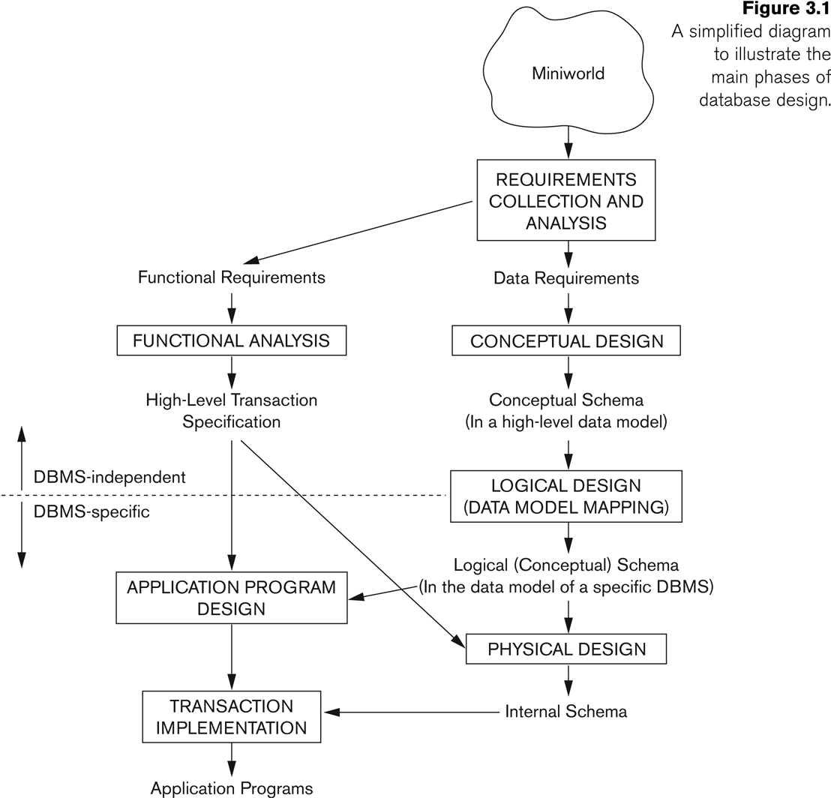
Overview of Database Design Process
E-R Model
(Entity types, Constraints,
Relationships)
Relational Model
(Database Schema)
Storage structure,
Index, Access path
Database file

Slide 8
Data Modeling Process
Conceptual Modeling
E-R Model → E-R Diagram
Object-Oriented Model → Class Diagram
Logical Modeling
Oracle, MySQL, SQL Server, DB2, Postgress, …
Physical Modeling
Modeling the physical model in storage devices

Slide 9
Methodologies for Conceptual Design
Entity Relationship (ER) Diagrams (This Chapter)
Enhanced Entity Relationship (EER) Diagrams (Chapter 4)
Use of Design Tools in industry for designing and documenting large scale designs
The UML (Unified Modeling Language) Class Diagrams are popular in industry to document conceptual database designs

Slide 10
A Sample Database Application

Slide 11
Example COMPANY Database
We need to create a database schema design based on the following (simplified) requirements of the COMPANY Database:
The company is organized into DEPARTMENTs.
Each department has a name, number and an employee who manages the department.
We keep track of the start date of the department manager.
A department may have several locations.
Each department controls a number of PROJECTs. Each project has a unique name, unique number and is located at a single location.

Slide 12
Example COMPANY Database (Continued)
The database will store each EMPLOYEE’s social security number, address, salary, sex, and birthdate.
Each employee works for one department but may work on several projects.
The DB will keep track of the number of hours per week that an employee currently works on each project.
It is required to keep track of the direct supervisor of each employee.
Each employee may have a number of DEPENDENTs.
For each dependent, the DB keeps a record of name, sex, birthdate, and relationship to the employee.

Slide 13
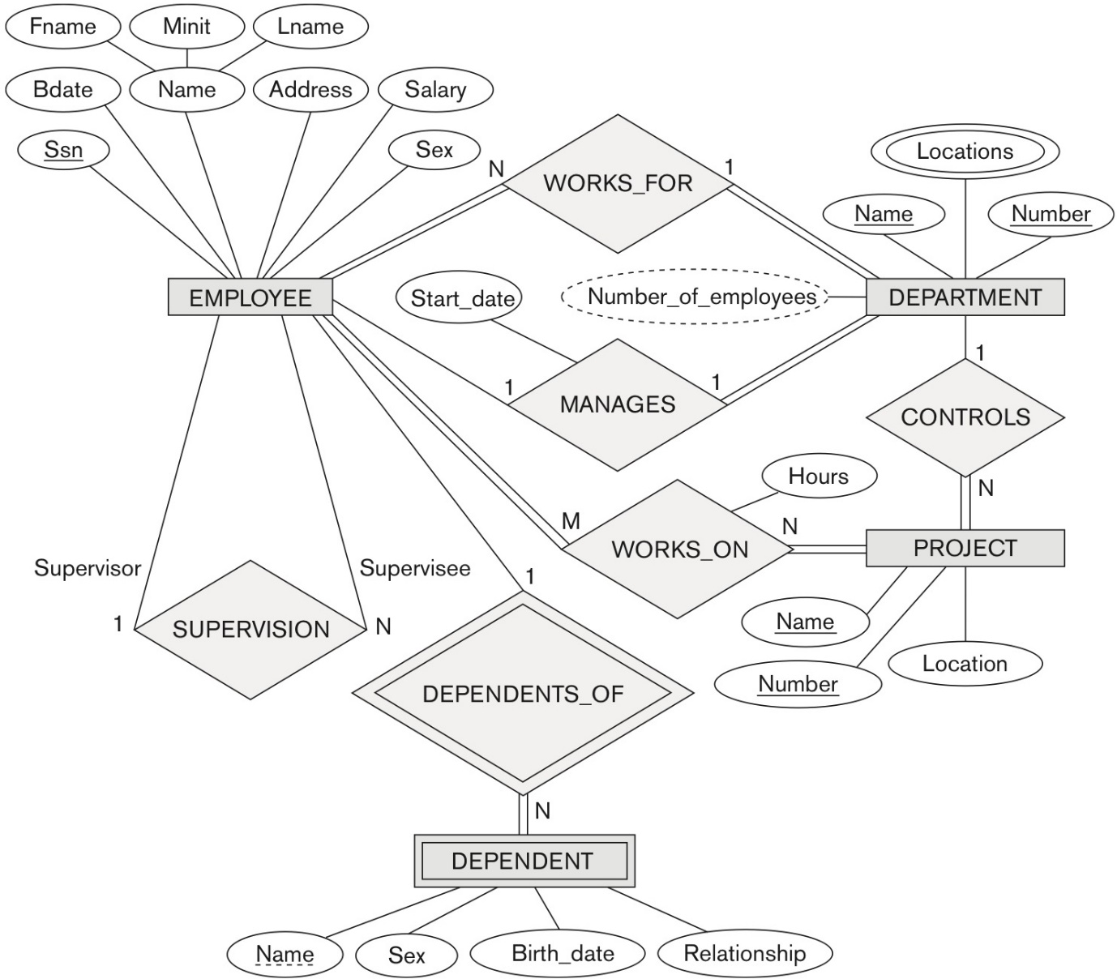
Example COMPANY Database (Continued)
Figure 3.2 An ER schema diagram for the COMPANY database. The diagrammatic notation is introduced gradually throughout this chapter and is summarized in Figure 3.14.

Slide 14
Entity Types, Entity Sets, Attributes, and Keys

Slide 15
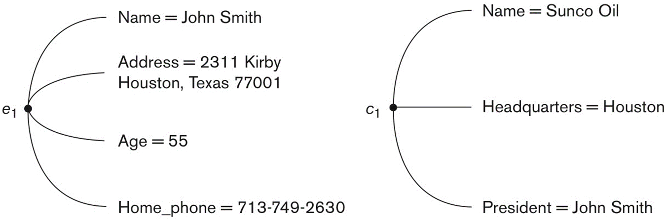
ER Model Concepts
Entities and Attributes
Entity is a basic concept for the ER model. Entities are specific things or objects in the mini-world that are represented in the database.
For example the EMPLOYEE John Smith, the Research DEPARTMENT, the ProductX PROJECT
Attributes are properties used to describe an entity.
For example an EMPLOYEE entity may have the attributes Name, SSN, Address, Sex, BirthDate
Figure 3.3 Two entities, EMPLOYEE e₁, and COMPANY c₁, and their attributes.

Slide 16
ER Model Concepts
A specific entity will have a value for each of its attributes.
For example a specific employee entity may have Name='John Smith', SSN=‘123456789’, Address =‘731, Fondren, Houston, TX’, Sex=‘M’, BirthDate=‘09-JAN-55’
Each attribute has a value set (or data type) associated with it – e.g. integer, string, date, enumerated type, …

Slide 17
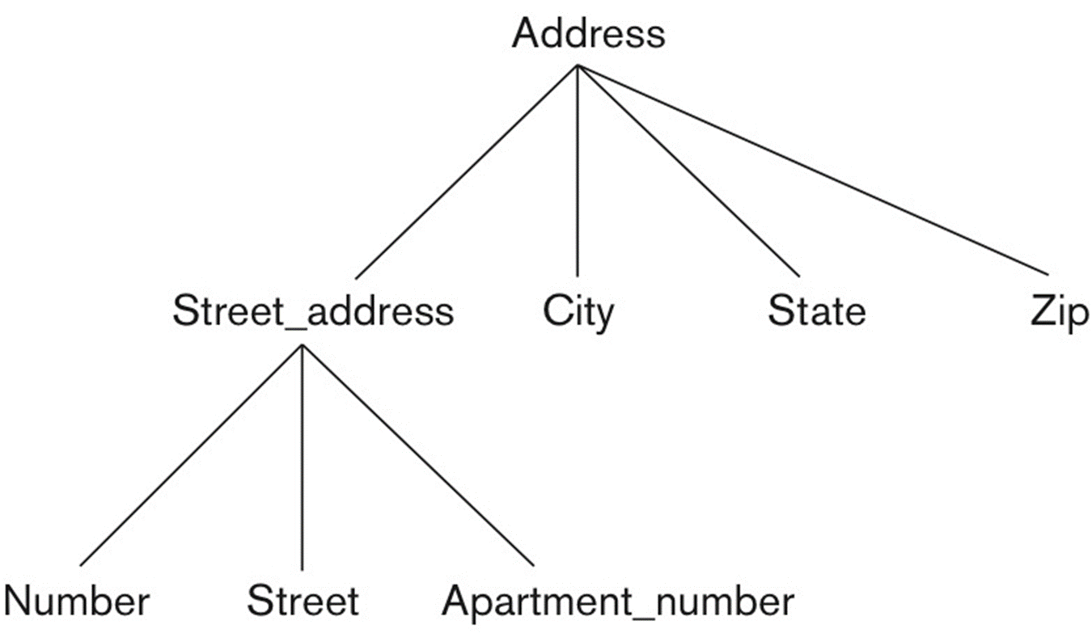
Types of Attributes (1)
Simple (단순)
Each entity has a single atomic value for the attribute. For example, SSN or Sex.
Composite (복합)
The attribute may be composed of several components. For example:
Address(Apt#, House#, Street, City, State, ZipCode, Country)
Name(FirstName, MiddleName, LastName).
Composition may form a hierarchy where some components are themselves composite.
Figure 3.4 A hierarchy of composite attributes.

Slide 18
Types of Attributes (2)
Multi-valued
An entity may have multiple values for that attribute. For example, Color of a CAR or PreviousDegrees of a STUDENT.
Denoted as {Color} or {PreviousDegrees}
In general, composite and multi-valued attributes may be nested arbitrarily to any number of levels, although this is rare.
For example, PreviousDegrees of a STUDENT is a composite multi-valued attribute denoted by {PreviousDegrees (College, Year, Degree, Field)}
Multiple PreviousDegrees values can exist
Each has four subcomponent attributes:
College, Year, Degree, Field
two tone car

Slide 19
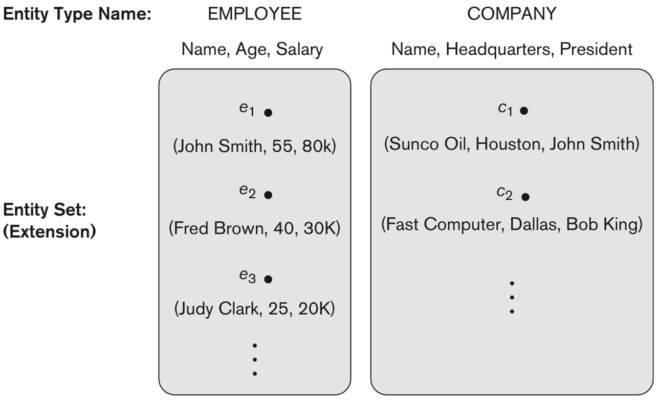
Entity Types and Key Attributes (1)
Entities with the same basic attributes are grouped or typed into an entity type.
For example, the entity type EMPLOYEE and PROJECT.
Figure 3.6 Two entity types, EMPLOYEE and COMPANY, and some member entities of each.

Slide 20
Entity Types and Key Attributes (2)
An attribute of an entity type for which each entity must have a unique value is called a key attribute of the entity type.
For example, SSN of EMPLOYEE.
A key attribute may be composite.
VehicleTagNumber is a key of the CAR entity type with components (Number, State).
Each key is underlined (Note: this is different from the relational schema where only one “primary key is underlined).

Slide 21
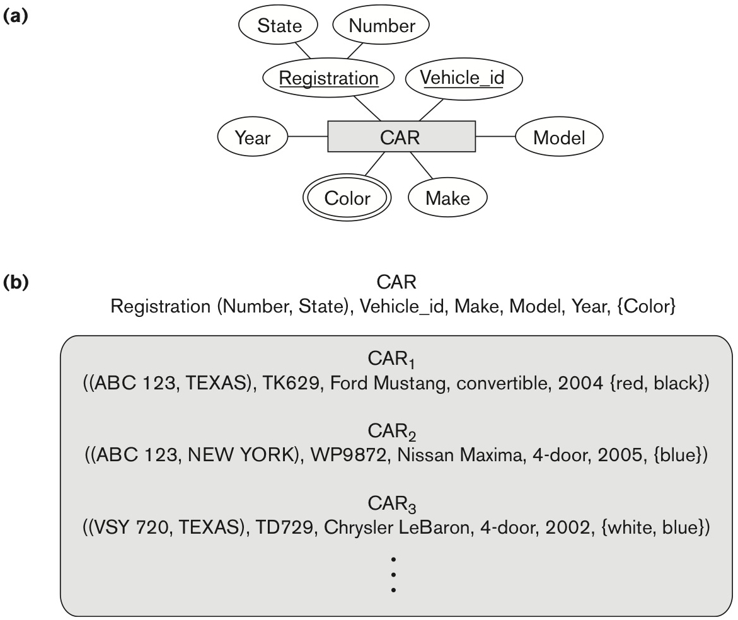
Entity Types and Key Attributes (3)
Figure 3.7 The CAR entity type with two key attributes, Registration and Vehicle_id. (a) ER diagram notation. (b) Entity set with three entities.

Slide 22
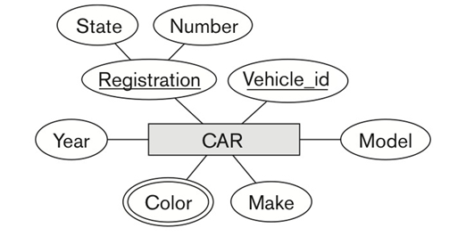
Entity Types and Key Attributes (4)
An entity type may have more than one key.
The CAR entity type may have two keys:
VehicleIdentificationNumber (popularly called VIN)
VehicleTagNumber (Number, State), aka license plate number.

Slide 23
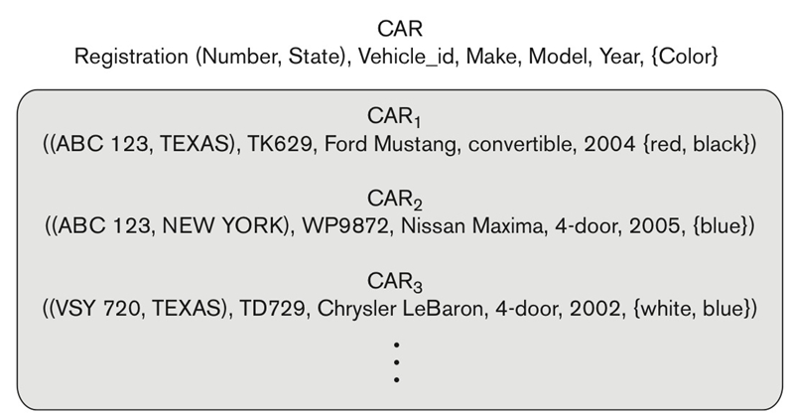
Entity Set (1)
Each entity type will have a collection of entities stored in the database
Called the entity set or sometimes entity collection
Same name (CAR) used to refer to both the entity type and the entity set

Slide 24
Entity Set (2)
However, entity type and entity set may be given different names
Entity set is the current state of the entities of that type that are stored in the database

Slide 25
Value Sets (Domains) of Attributes
Each simple attribute is associated with a value set
E.g., Lastname has a value which is a character string of upto 15 characters
Date has a value consisting of MM-DD-YYYY where each letter is an integer
A value set specifies the set of values associated with an attribute. Value set = domain of values
Value sets are similar to data types in most programming languages – e.g., integer, character (n), real, bit

Slide 26
Displaying an Entity type
In ER diagrams, an entity type is displayed in a rectangular box
Attributes are displayed in ovals
Each attribute is connected to its entity type
Components of a composite attribute are connected to the oval representing the composite attribute
Each key attribute is underlined
Multivalued attributes displayed in double ovals

Slide 27
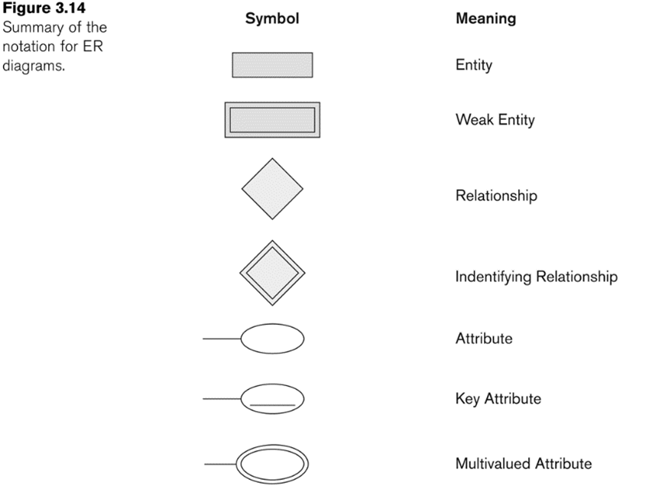
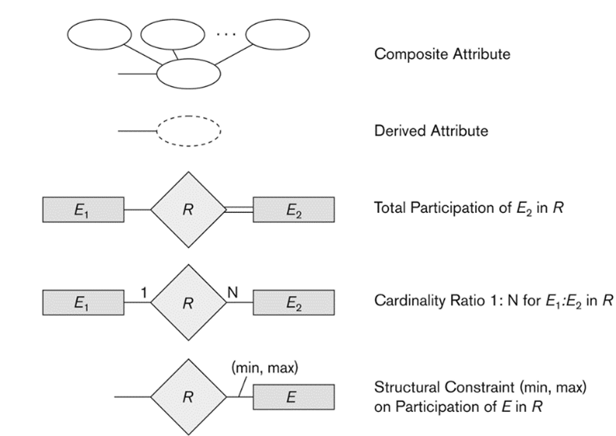
NOTATION for ER diagrams

Slide 28
Initial Conceptual Design of Entity Types for the COMPANY Database Schema
Based on the requirements, we can identify four initial entity types in the COMPANY database:
DEPARTMENT
PROJECT
EMPLOYEE
DEPENDENT
Their initial conceptual design is shown on the following slide
The initial attributes shown are derived from the requirements description

Slide 29
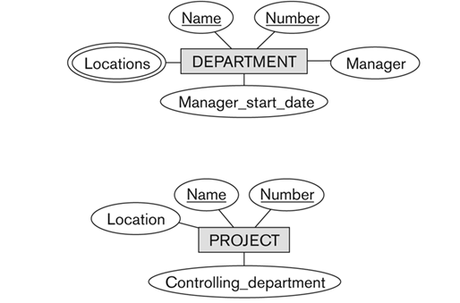
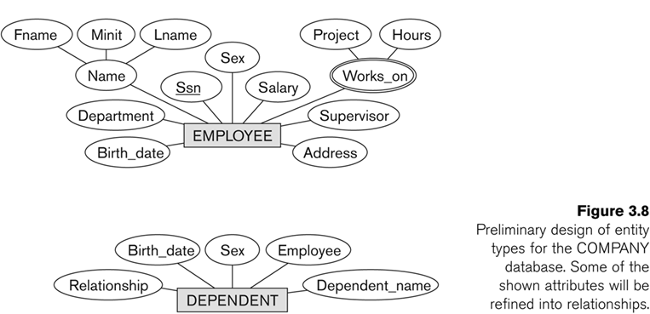
Initial Design of Entity Types: EMPLOYEE, DEPARTMENT, PROJECT, DEPENDENT
relationship type
relationship type
refinement required
(implicit relationships)

Slide 30
Relationship Types, Relationship Sets, Roles, and Structural Constraints

Slide 31
Refining the initial design by introducing relationships
The initial design is typically not complete
Some aspects in the requirements will be represented as relationships
ER model has three main concepts:
Entities (and their entity types and entity sets)
Attributes (simple, composite, multivalued)
Relationships (and their relationship types and relationship sets)

Slide 32
Relationships and Relationship Types (1)
A relationship relates two or more distinct entities with a specific meaning.
For example, EMPLOYEE John Smith works on the ProductX PROJECT, or EMPLOYEE Franklin Wong manages the Research DEPARTMENT.
Relationships of the same type are grouped or typed into a relationship type.
For example, the WORKS_ON relationship type in which EMPLOYEEs and PROJECTs participate, or the MANAGES relationship type in which EMPLOYEEs and DEPARTMENTs participate.
The degree of a relationship type is the number of participating entity types.
Both MANAGES and WORKS_ON are binary relationships.

Slide 33
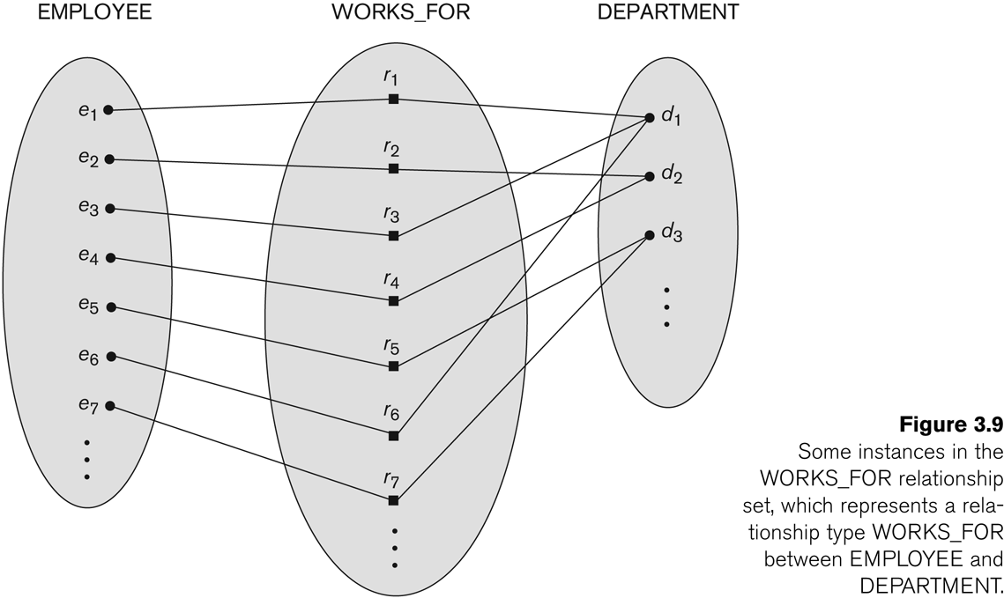
N:1 Relationship: EMPLOYEE and DEPARTMENT
entity type
relationship type
entity type
entity
entity
entity set
entity set
relationship set
relationship instance

Slide 34
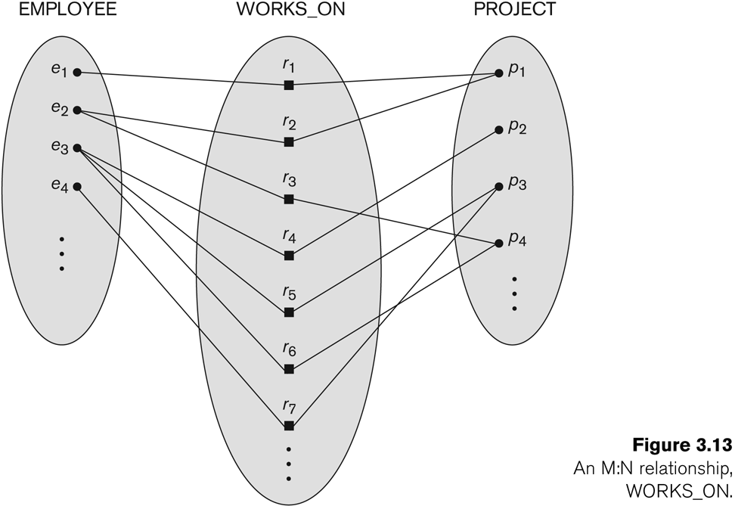
M:N Relationship: EMPLOYEE and PROJECT

Slide 35
Relationship type vs. relationship set (1)
Relationship Type:
Is the schema description of a relationship
Identifies the relationship name and the participating entity types
Also identifies certain relationship constraints
Relationship Set:
The current set of relationship instances represented in the database
The current state of a relationship type

Slide 36
Relationship type vs. relationship set (2)
Each instance in the set relates individual participating entities – one from each participating entity type
In ER diagrams, we represent the relationship type as follows:
Diamond-shaped box is used to display a relationship type
Connected to the participating entity types via straight lines
Note that the relationship type is not shown with an arrow. The name should be typically be readable from left to right and top to bottom.
EMPLOYEE WORK_ON PROJECT
EMPLOYEE WORK_FOR DEPARTMENT

Slide 37
Refining the COMPANY database schema by introducing relationships
By examining the requirements, six relationship types are identified
All are binary relationships(degree 2)
Listed below with their participating entity types:
WORKS_FOR (between EMPLOYEE, DEPARTMENT)
MANAGES (also between EMPLOYEE, DEPARTMENT)
CONTROLS (between DEPARTMENT, PROJECT)
WORKS_ON (between EMPLOYEE, PROJECT)
SUPERVISION (between EMPLOYEE (as subordinate), EMPLOYEE (as supervisor))
DEPENDENTS_OF (between EMPLOYEE, DEPENDENT)

Slide 38
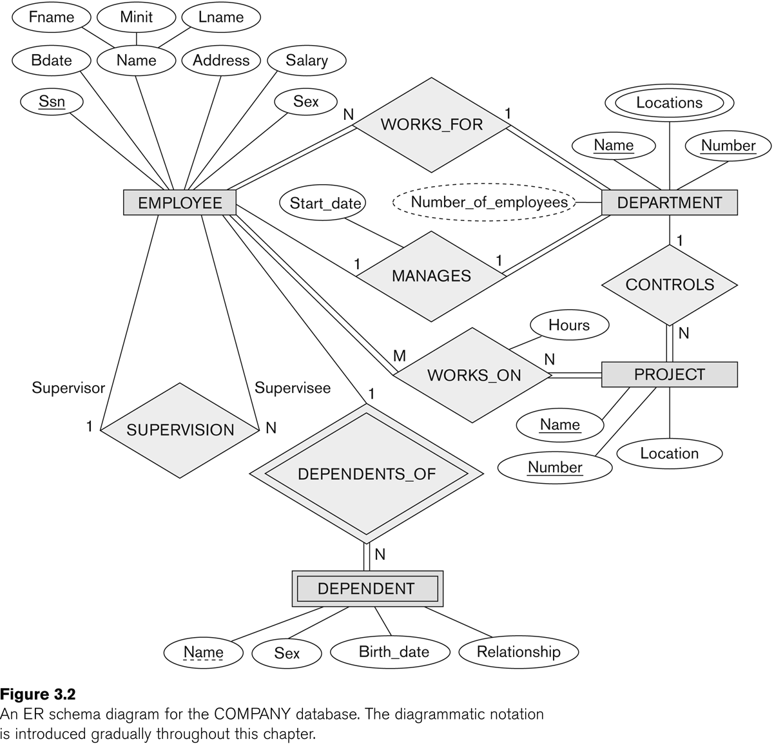
ER DIAGRAM
Relationship Types:
WORKS_FOR
MANAGES
WORKS_ON
CONTROLS
SUPERVISION
DEPENDENTS_OF

Slide 39
Discussion on Relationship Types
In the refined design, some attributes from the initial entity types are refined into relationships:
Manager of DEPARTMENT → MANAGES
Works_on of EMPLOYEE → WORKS_ON
Department of EMPLOYEE → WORKS_FOR
etc
In general, more than one relationship type can exist between the same participating entity types
MANAGES and WORKS_FOR are distinct relationship types between EMPLOYEE and DEPARTMENT
Different meanings and different relationship instances.

Slide 40
Constraints on Relationships
Constraints on Relationship Types
(Also known as ratio constraints)
Cardinality Ratio (specifies maximum participation)
One-to-one (1:1)
One-to-many (1:N) or Many-to-one (N:1)
Many-to-many (M:N)
Existence Dependency Constraint (specifies minimum participation) (also called participation constraint) ex. Dependents
zero (optional participation, not existence-dependent)
one or more (mandatory participation, existence-dependent)

Slide 41
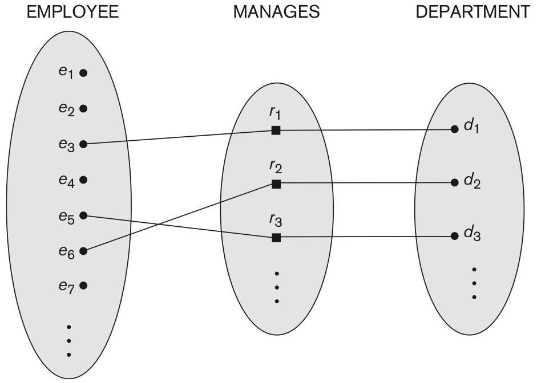
one-to-one (1:1) Relationship
Figure 3.12 A 1:1 relationship, MANAGES.

Slide 42
Many-to-one (N:1) Relationship

Slide 43
Many-to-many (M:N) Relationship
one-to-many
many-to-one

Slide 44
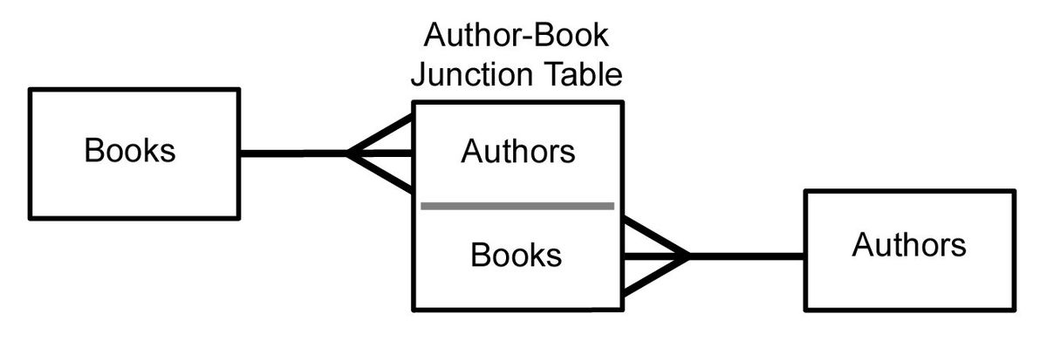
Many-to-many (M:N) Relationship
Books
Authors
many-to-many
one-to-many & many-to-one
https://en.wikipedia.org/wiki/File:Databases-ManyToManyWJunction.jpg

Slide 45
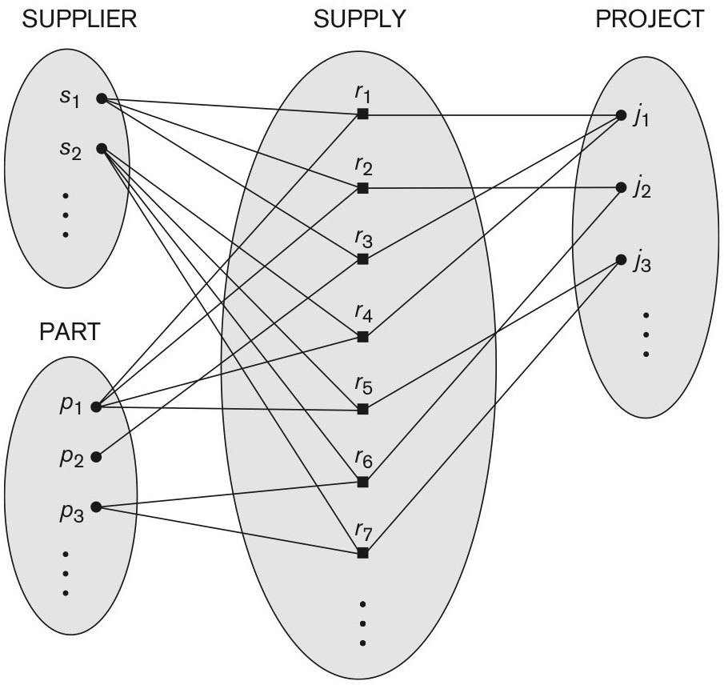
Ternary Relationship
s supplies part p to project j
Figure 3.10 Some relationship instances in the SUPPLY ternary relationship set.

Slide 46
Recursive Relationship Type
A relationship type between the same participating entity type in distinct roles
Also called a self-referencing relationship type.
Example: the SUPERVISION relationship
PREREQUISITE
EMPLOYEE participates twice in two distinct roles:
supervisor (or boss) role
supervisee (or subordinate) role
Each relationship instance relates two distinct EMPLOYEE entities:
One employee in supervisor role
One employee in supervisee role

Slide 47
Displaying a recursive relationship
In a recursive relationship type.
Both participations are the same entity type in different roles.
For example, SUPERVISION relationships between EMPLOYEE (in role of supervisor or boss) and (another) EMPLOYEE (in role of subordinate or worker).
In following figure, first role participation labeled with 1 and second role participation labeled with 2.
In ER diagram, need to display role names to distinguish participations.

Slide 48
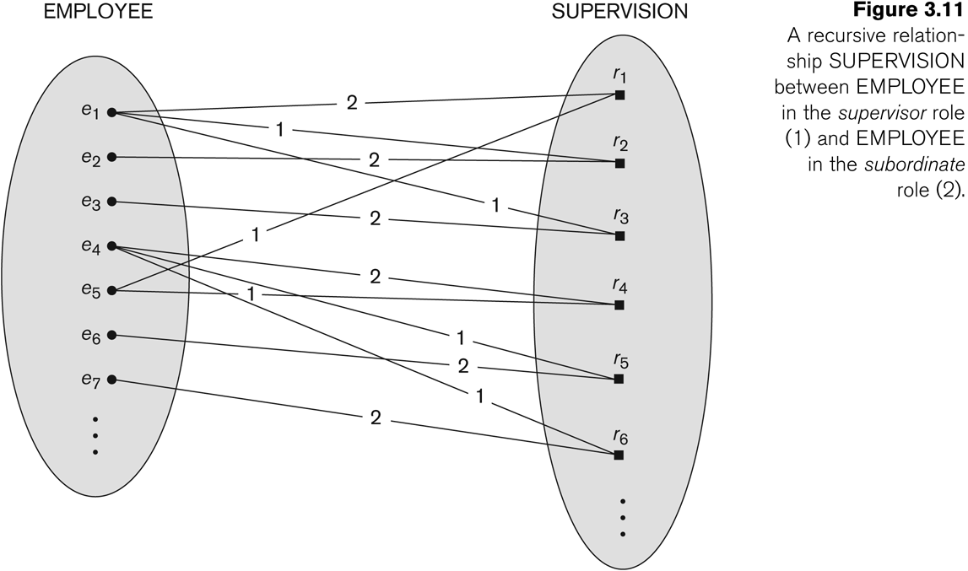
A Recursive Relationship Supervision
supervisee
supervisor

Slide 49
Recursive Relationship Type is: SUPERVISION (participation role names are shown)

Slide 50
Weak Entity Types

Slide 51
Weak Entity Types
An entity that does not have a key attribute and that is identification-dependent on another entity type.
A weak entity must participate in an identifying relationship type with an owner or identifying entity type
Entities are identified by the combination of:
A partial key of the weak entity type
The particular entity they are related to in the identifying relationship type
Example:
A DEPENDENT entity is identified by the dependent’s first name, and the specific EMPLOYEE with whom the dependent is related
Name of DEPENDENT is the partial key
DEPENDENT is a weak entity type
EMPLOYEE is its identifying entity type via the identifying relationship type DEPENDENT_OF

Slide 52
Weak Entity Types
strong entity
identifying type or
owner entity type
Entities belonging to a weak entity type are identified by being related to specific entities from another entity type in combination with one of their attribute values.
identifying relationship
|| total participation
constraint
partial key
weak entity

Slide 53
Attributes of Relationship types
A relationship type can have attributes:
For example, HoursPerWeek of WORKS_ON
Its value for each relationship instance describes the number of hours per week that an EMPLOYEE works on a PROJECT.
A value of HoursPerWeek depends on a particular (employee, project) combination
Most relationship attributes are used with M:N relationships
In 1:N relationships, they can be transferred to the entity type on the N-side of the relationship

Slide 54
Example Attribute of a Relationship Type: Hours of WORKS_ON

Slide 55
Notation for Constraints on Relationships
Cardinality ratio (of a binary relationship): 1:1, 1:N, N:1, or M:N
Shown by placing appropriate numbers on the relationship edges.
Participation constraint (on each participating entity type): total (called existence dependency) or partial.
Total shown by double line, partial by single line.
NOTE: These are easy to specify for Binary Relationship Types.

Slide 56
Alternative (min, max) notation for relationship structural constraints:
Specified on each participation of an entity type E in a relationship type R
Specifies that each entity e in E participates in at least min and at most max relationship instances in R
Default(no constraint): min=0, max=n (signifying no limit)
Must have min ≤ max, min ≥ 0, max ≥ 1

Slide 57
Alternative (min, max) notation for relationship structural constraints:
Derived from the knowledge of mini-world constraints
Examples:
A department has exactly one manager and an employee can manage at most one department.
Specify (0,1) for participation of EMPLOYEE in MANAGES
Specify (1,1) for participation of DEPARTMENT in MANAGES
An employee can work for exactly one department but a department can have any number of employees.
Specify (1,1) for participation of EMPLOYEE in WORKS_FOR
Specify (0,n) for participation of DEPARTMENT in WORKS_FOR

Slide 58
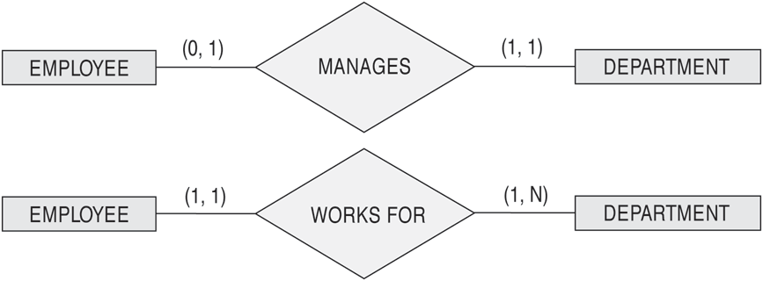
The (min, max) notation for relationship constraints
Read the min, max numbers next to the entity type

Slide 59
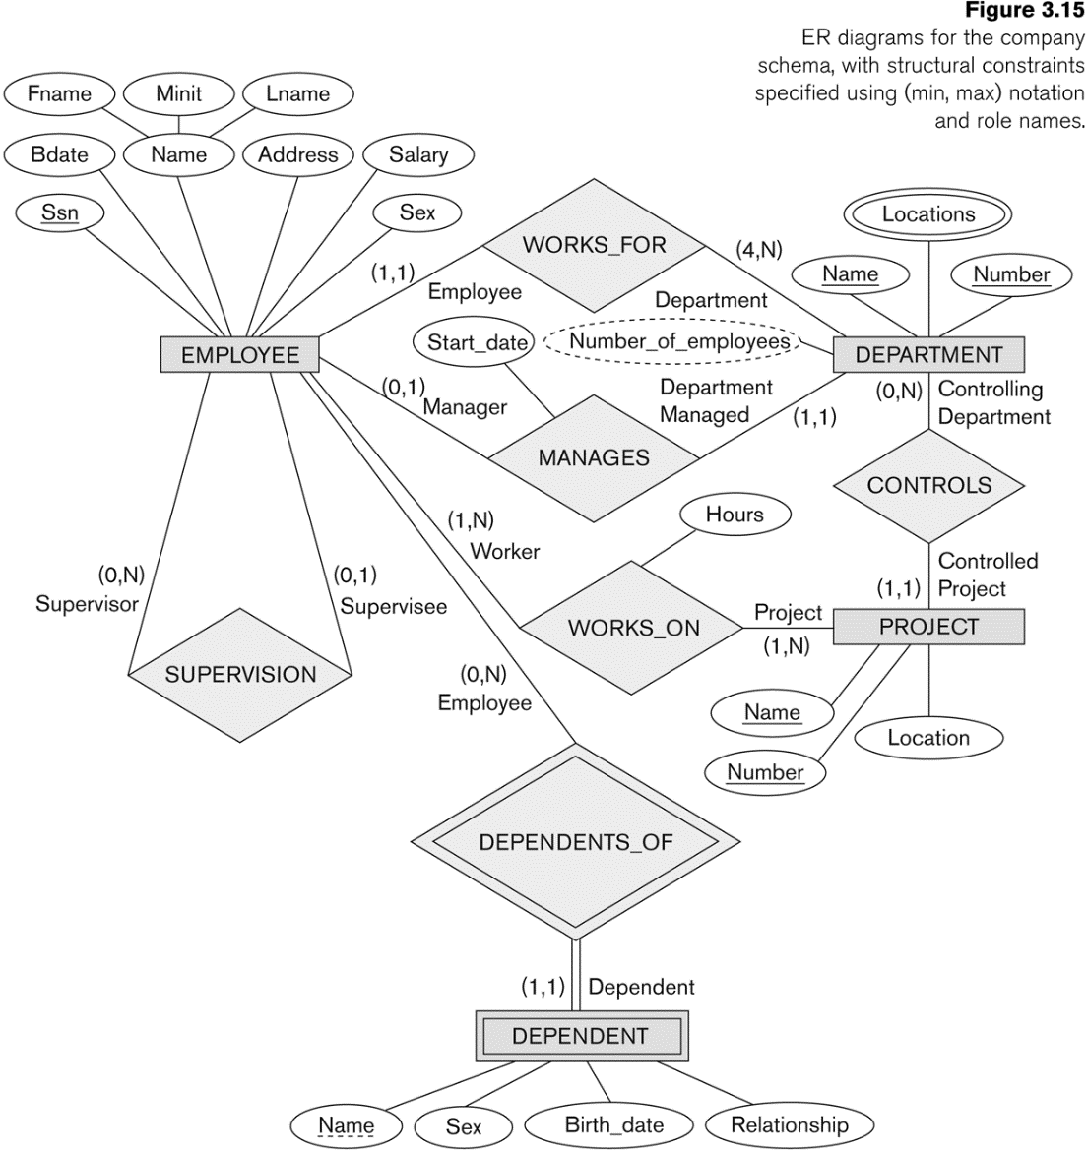
COMPANY ER Schema Diagram using (min, max) notation

Slide 60
ER Diagrams, Naming Conventions and Design Issues

Slide 61
Alternative diagrammatic notation
ER diagrams is one popular example for displaying database schemas
Many other notations exist in the literature and in various database design and modeling tools
UML class diagrams is representative of another way of displaying ER concepts that is used in several commercial design tools

Slide 62
Summary of notation for ER diagrams

Slide 63
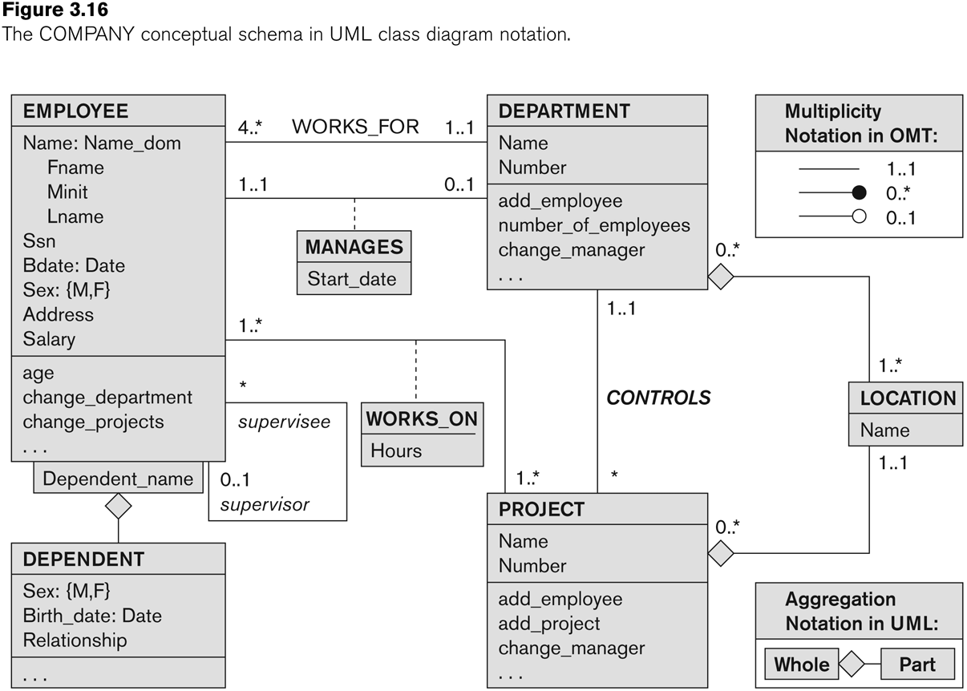
UML class diagram for COMPANY database schema

Slide 64
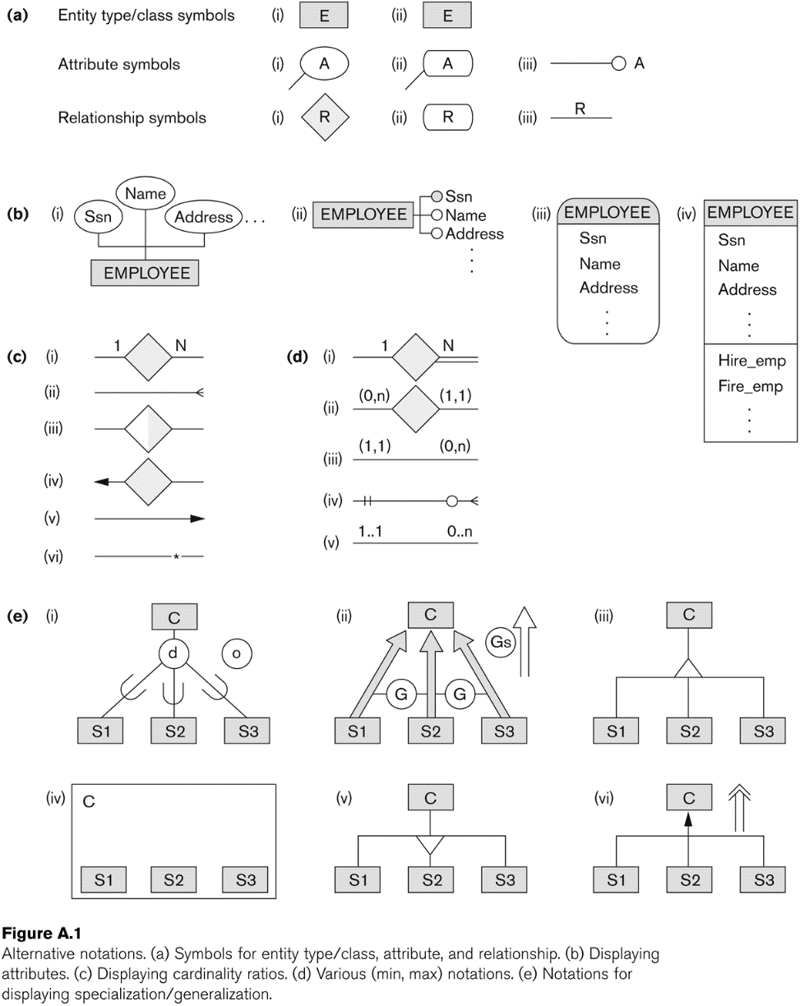
Other alternative diagrammatic notations

Slide 65
Relationship Types of Degree Higher than Two

Slide 66
Relationships of Higher Degree
Relationship types of degree 2 are called binary
Relationship types of degree 3 are called ternary and of degree n are called n-ary
In general, an n-ary relationship is not equivalent to n binary relationships
Constraints are harder to specify for higher-degree relationships (n > 2) than for binary relationships

Slide 67
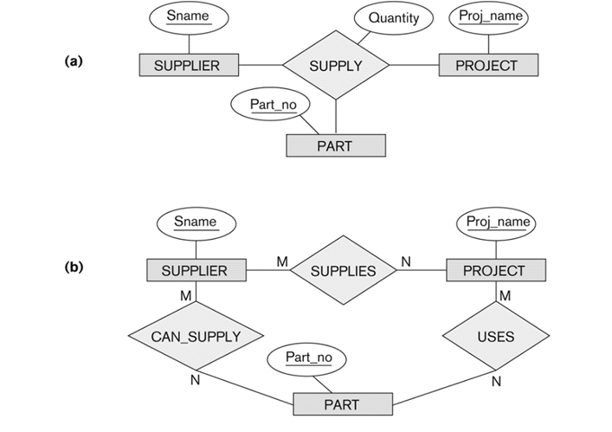
Discussion of n-ary relationships (n > 2)
In general, 3 binary relationships can represent different information than a single ternary relationship (see a and b)
SUPPLIER s
PART p
PROJECT j
(s, j, p)
(s, j)
(s, p)
(j, p)
(s, j)
(s, p)
(j, p)
not imply (s, j, p)

Slide 68
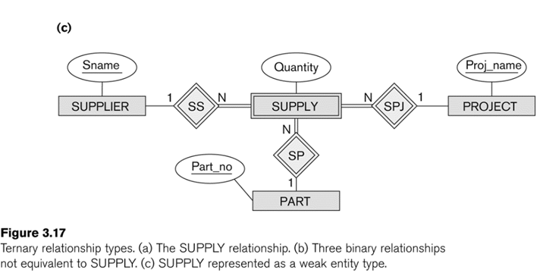
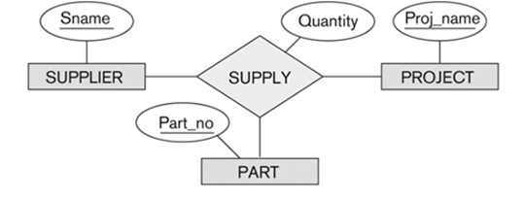
Discussion of n-ary relationships (n > 2)
If needed, the binary and n-ary relationships can all be included in the schema design (see Figure 3.17a and b, where all relationships convey different meanings)
In some cases, a ternary relationship can be represented as a weak entity if the data model allows a weak entity type to have multiple identifying relationships (and hence multiple owner entity types) (see Figure 3.17c)

Slide 69
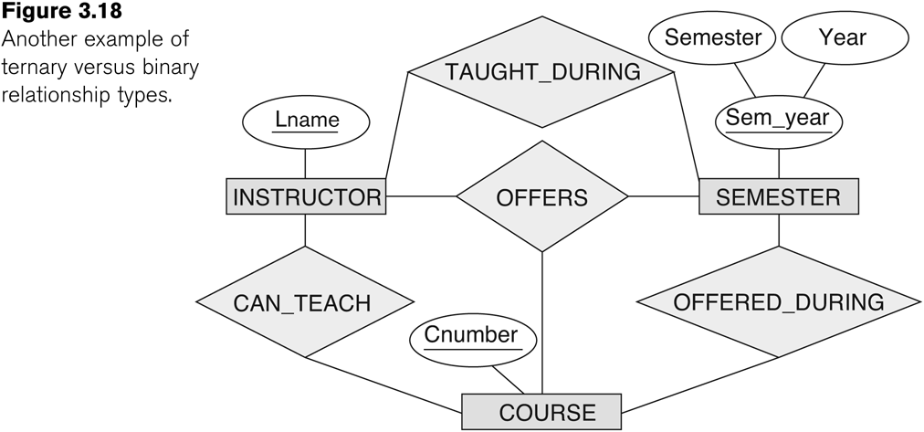
Discussion of n-ary relationships (n > 2)
If a particular binary relationship can be derived from a higher-degree relationship at all times, then it is redundant
For example, the TAUGHT_DURING binary relationship in Figure 3.18 can be derived from the ternary relationship OFFERS (based on the meaning of the relationships)

Slide 70
Another example of a ternary relationship
INSTRUCTOR i
SEMESTER s
COURSE c
a relationship instance (i, s, c) should not exist in OFFERS unless an instance (i, s) exists in TAUGHT_DURING, and instance (s, c) exists in OFFERED_DURING, and an instance (i, c) exists in CAN_TEACH. However, the reverse is not always true.

Slide 71
Another example of a ternary relationship
INSTRUCTOR i
SEMESTER s
COURSE c
We can infer the instances of TAUGHT_DURING and OFFERED_DURING from the instances in OFFERS, but we cannot infer the instances of CAN_TEACH; therefore, TAUGHT_DURING and OFFERED_DURING are redundant and can be left out.
Not all (i, c) can be inferred from all (i, s, c).

Slide 72
Another Example: A UNIVERSITY Database

Slide 73
Another Example: A UNIVERSITY Database(p122)
To keep track of the enrollments in classes and student grades, another database is to be designed.
It keeps track of the COLLEGEs, DEPARTMENTs within each college, the COURSEs offered by departments, and SECTIONs of courses, INSTRUCTORs who teach the sections etc.
These entity types and the relationships among these entity types are shown on the next slide.

Slide 74
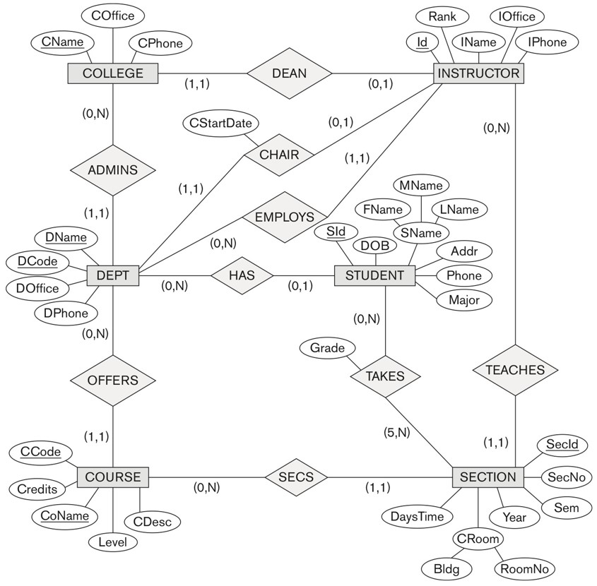
UNIVERSITY database conceptual schema
a college must have one dean
an instructor may or may not be a dean of a college
*(zero or more) students take section
a students takes *(zero or more) sections
section must have at least 5 students

Slide 75
Chapter Summary
ER Model Concepts: Entities, attributes, relationships
Constraints in the ER model
Using ER in step-by-step mode conceptual schema design for the COMPANY database
ER Diagrams - Notation
Alternative Notations – UML class diagrams, others
Binary Relationship types and those of higher degree.

Slide 76
Data Modeling Tools (Additional Material )
A number of popular tools that cover conceptual modeling and mapping into relational schema design.
Examples: ERWin, S- Designer (Enterprise Application Suite), ER- Studio, etc.
POSITIVES:
Serves as documentation of application requirements, easy user interface - mostly graphics editor support
NEGATIVES:
Most tools lack a proper distinct notation for relationships with relationship attributes
Mostly represent a relational design in a diagrammatic form rather than a conceptual ER-based design

Slide 77
Some of the Automated Database Design Tools (Note: Not all may be on the market now)
COMPANY | TOOL | FUNCTIONALITY
Embarcadero Technologies | ER Studio | Database Modeling in ER and IDEF1X
 | DB Artisan | Database administration, space and security management
Oracle | Developer 2000/Designer 2000 | Database modeling, application development
Popkin Software | System Architect 2001 | Data modeling, object modeling, process modeling, structured analysis/design
Platinum (Computer Associates) | Enterprise Modeling Suite: Erwin, BPWin, Paradigm Plus | Data, process, and business component modeling
Persistence Inc. | Pwertier | Mapping from O-O to relational model
Rational (IBM) | Rational Rose | UML Modeling & application generation in C++/JAVA
Resolution Ltd. | Xcase | Conceptual modeling up to code maintenance
Sybase | Enterprise Application Suite | Data modeling, business logic modeling
Visio | Visio Enterprise | Data modeling, design/reengineering Visual Basic/C++

